Slide 1
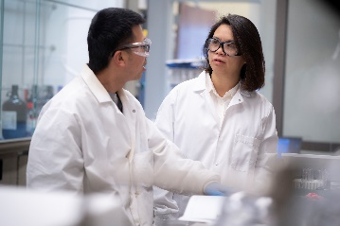
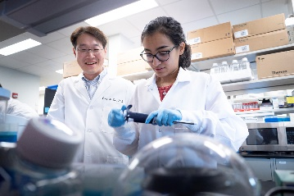
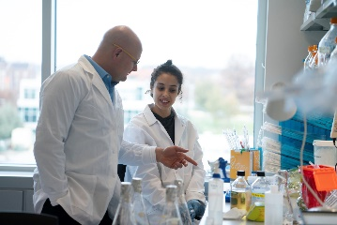
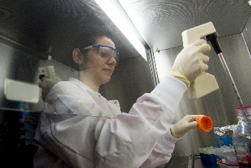
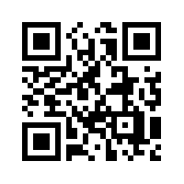
SAVE THE DATE!
LAB EXPEDITION
FIND YOUR SCIENCE
DATE: Wednesday, November 6th, 2019
TIME: 7:00 pm
WHERE: HCRS 1054
(Honor’s College and Residences: 1101 Third Street, West Lafayette, IN 47906)
Are you interested in joining a lab to gain experience in research?
Do you have questions about career choices?
Are you curious about grad school?
Join us for a conversation with graduate students who will give brief presentations of their research, and also talk about their experiences before and after joining a lab and why they chose grad school. Snacks and refreshments will be served to attendees of this exciting event. Let us know about your interests by answering a few questions here.
(https://docs.google.com/forms/d/1dFAEoO9S-V_VKm89vtt847wVTQ3LMhU9tJ-kWURjazw/viewform?edit_requested=true)

